Slide 1
Capstone Project: Predicting Interest Rates
Daniel Groneberg

Slide 2
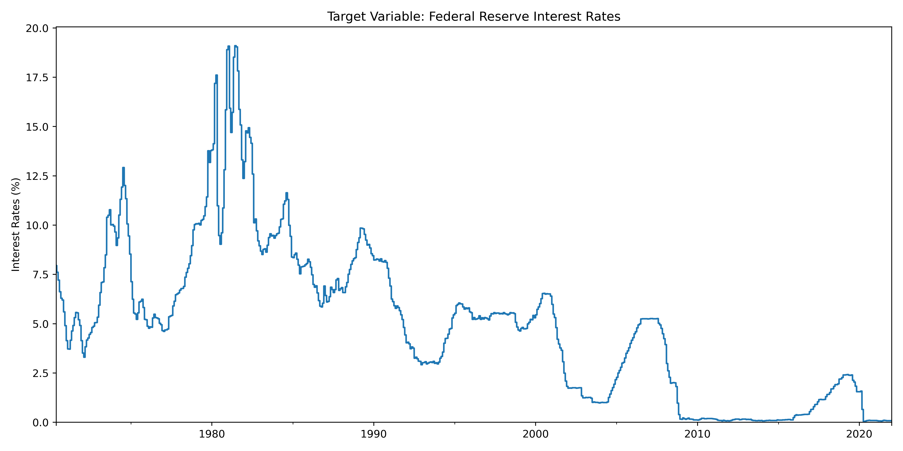
Goal: Forecast Federal Reserve Interest Rates

Slide 3
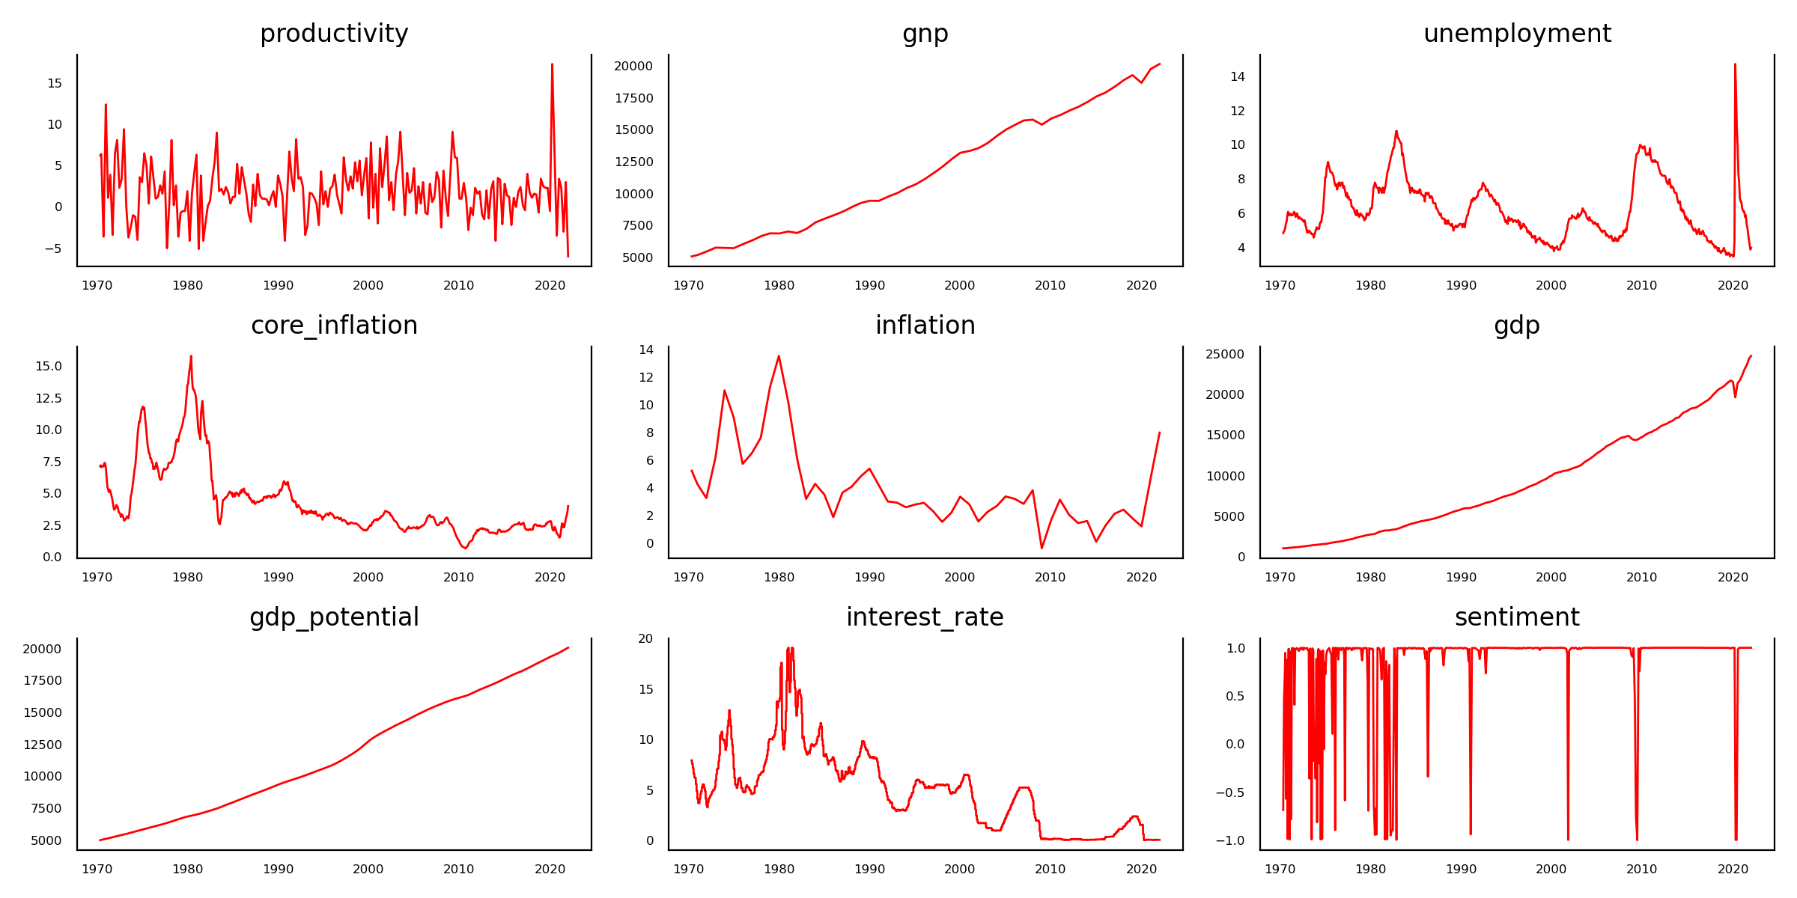
Goal: Included Features

Slide 4
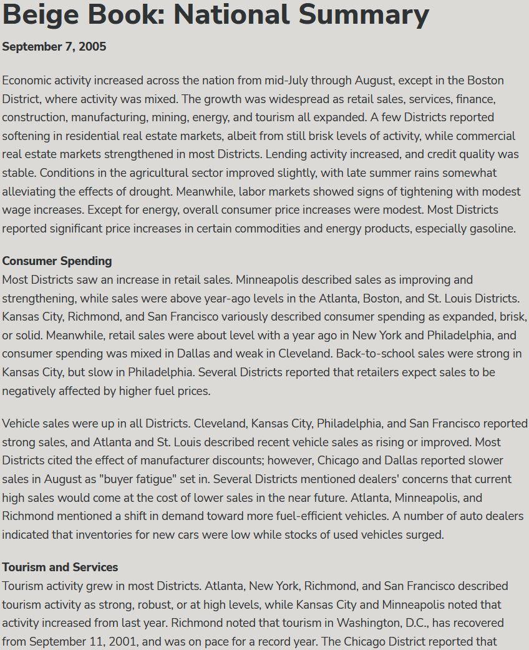
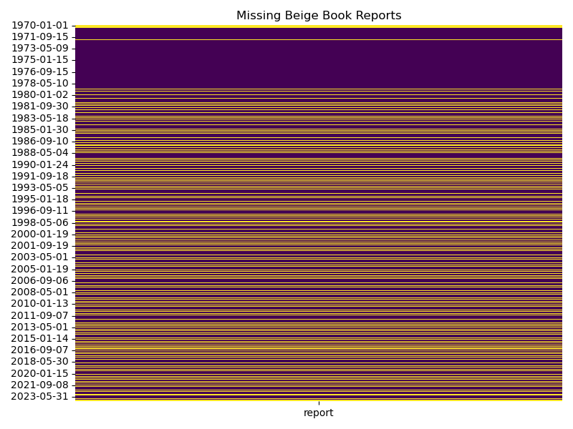
Feature: Beige Book Data

Slide 5
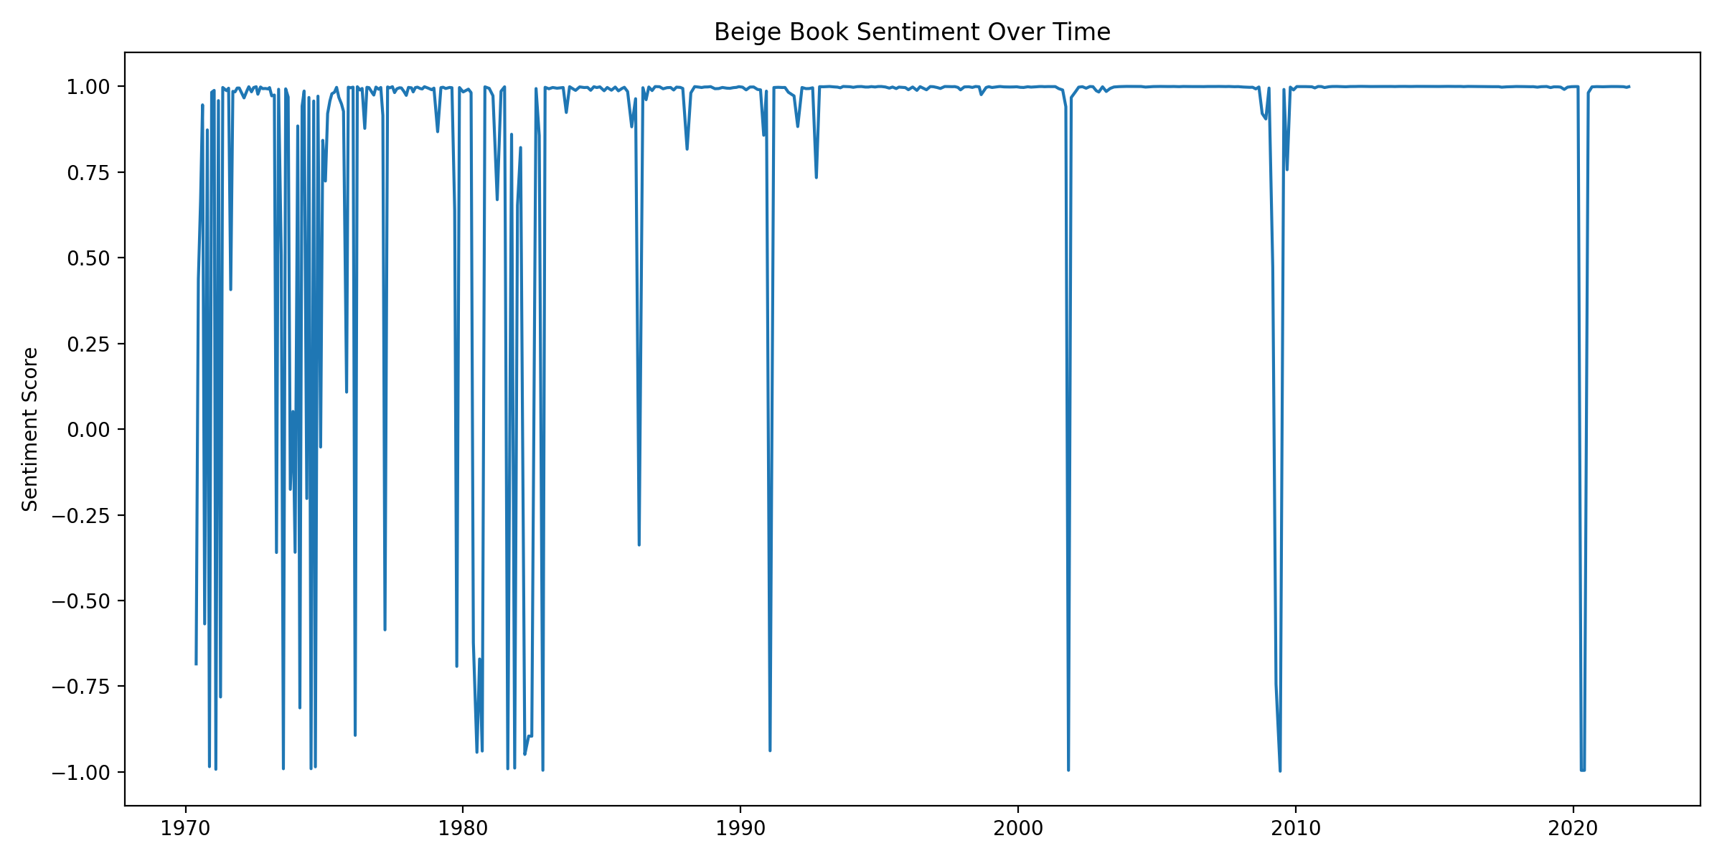
Feature: Beige Book Sentiment

Slide 6
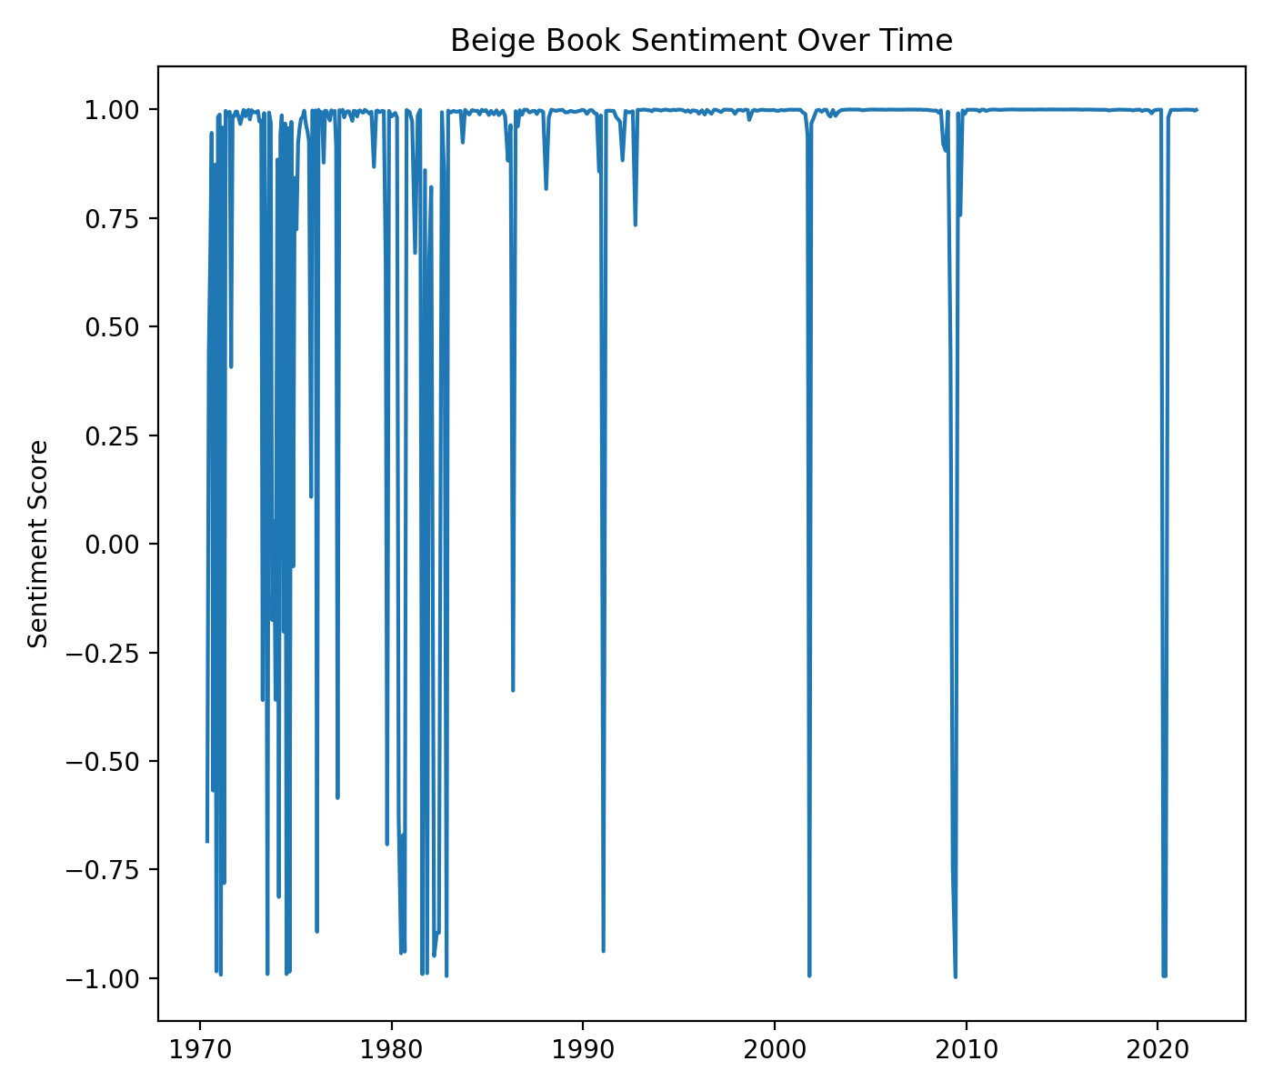
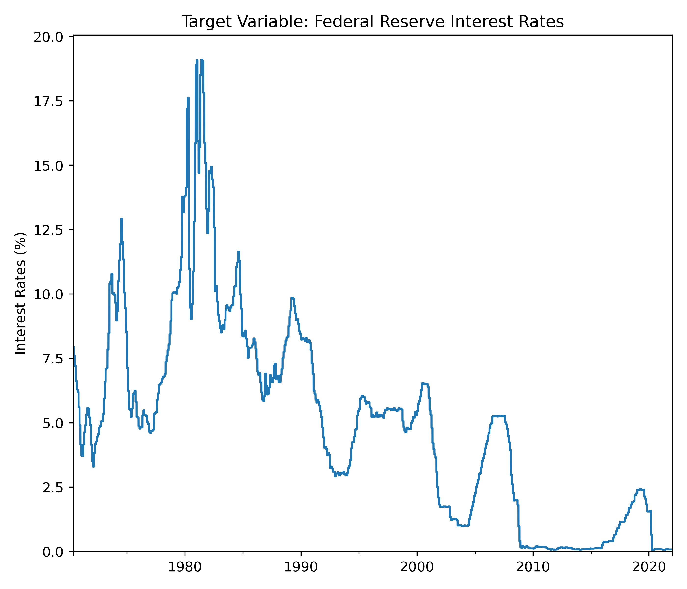
Feature: Beige Book Sentiment

Slide 7
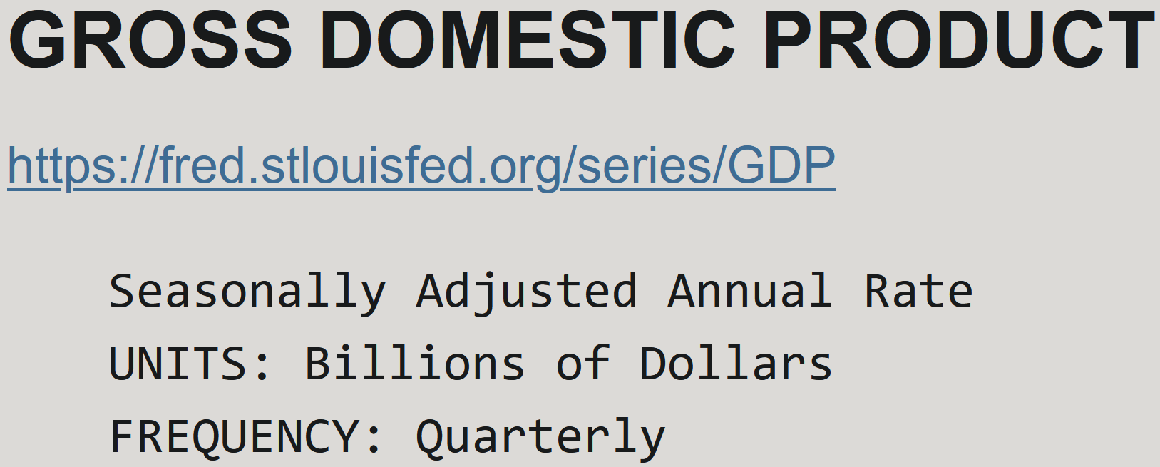
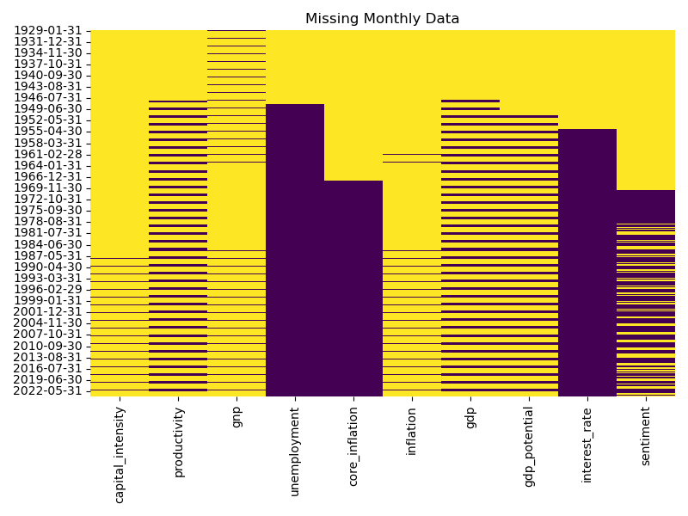
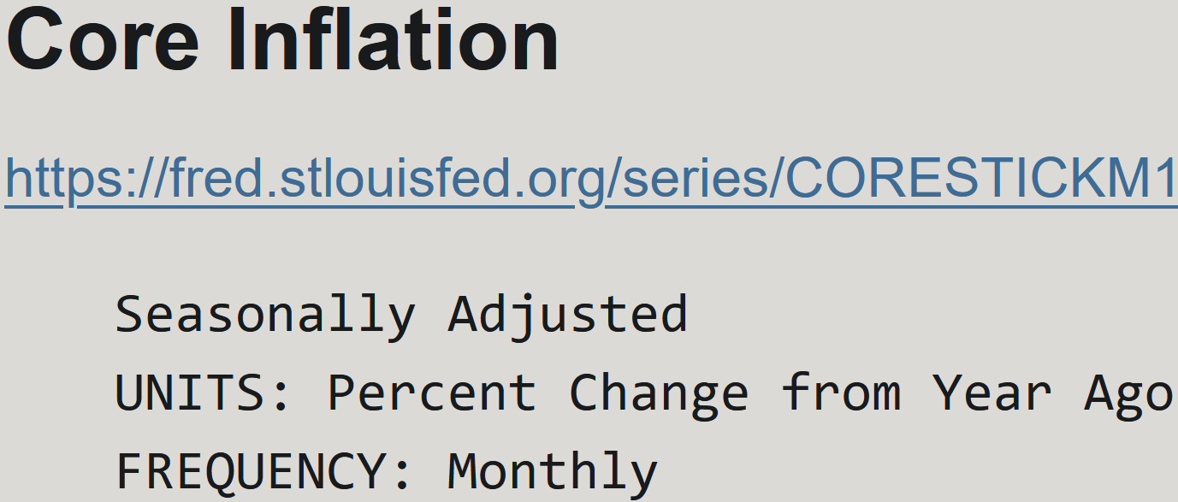
Imputing Data: Frequencies

Slide 8
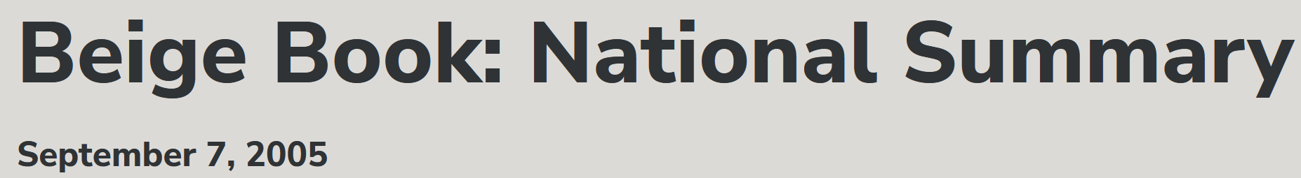
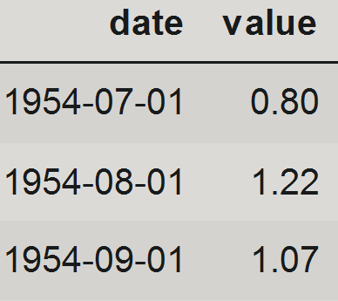
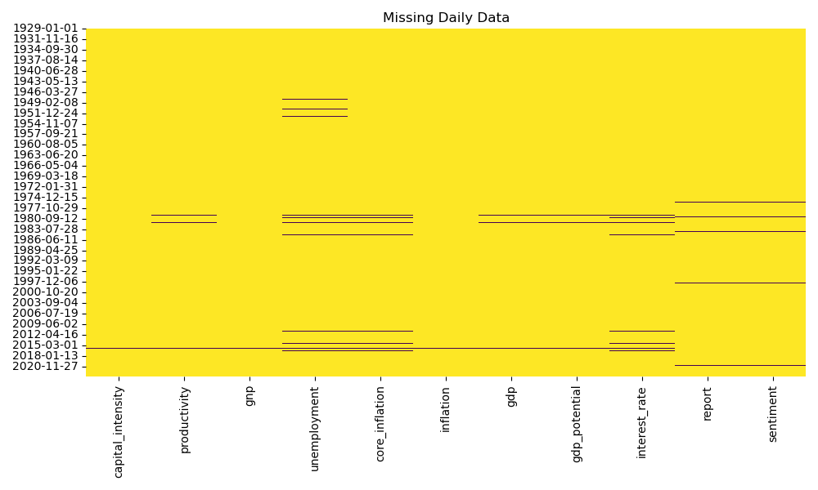
Imputing Data: Frequencies

Slide 9
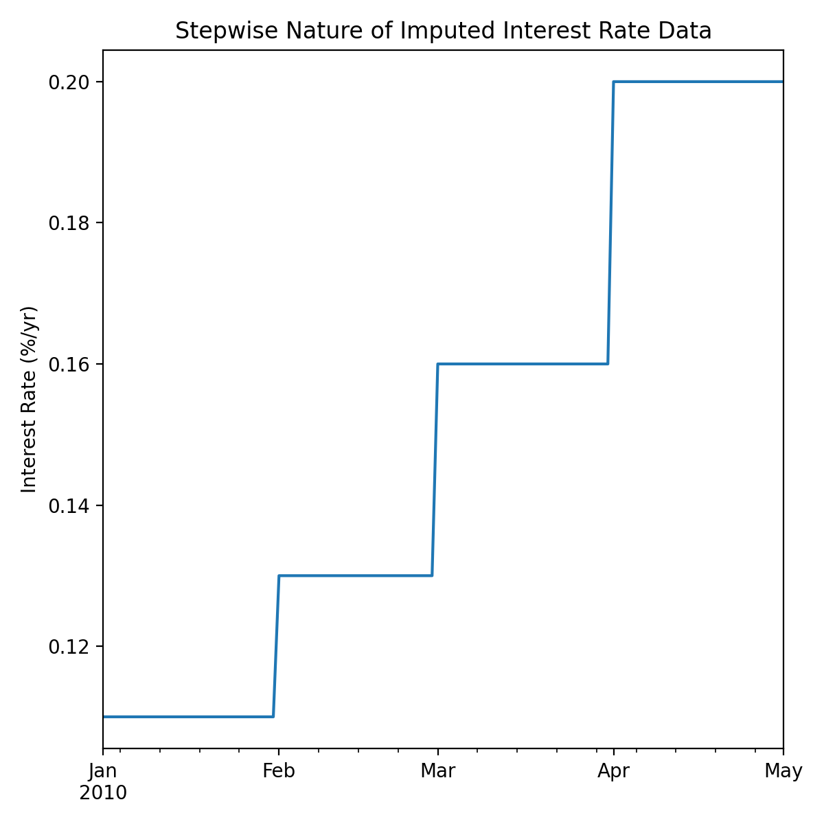
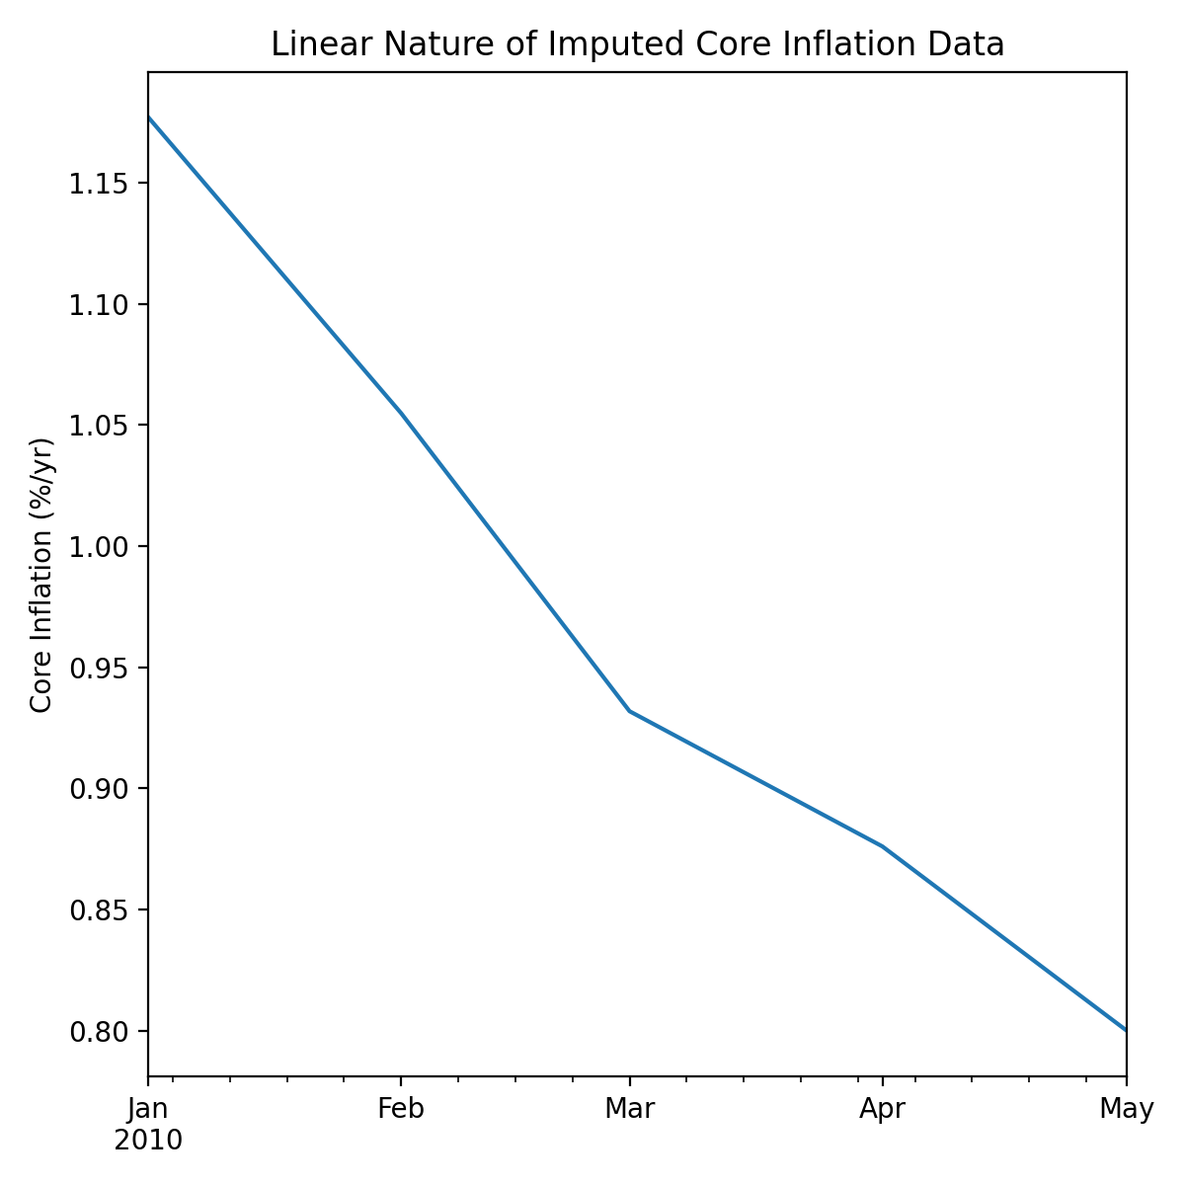
Imputing Data: Method

Slide 10
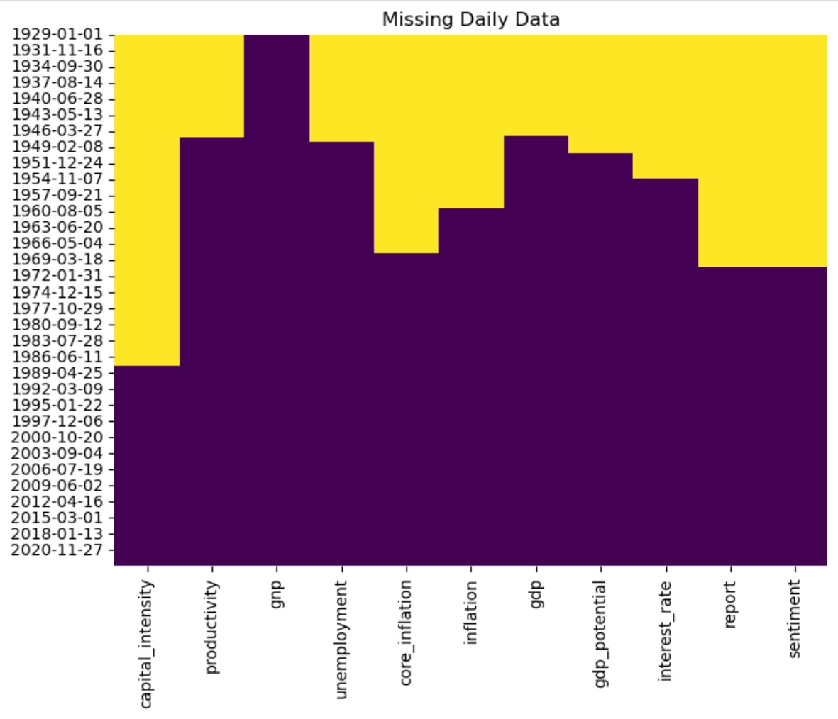
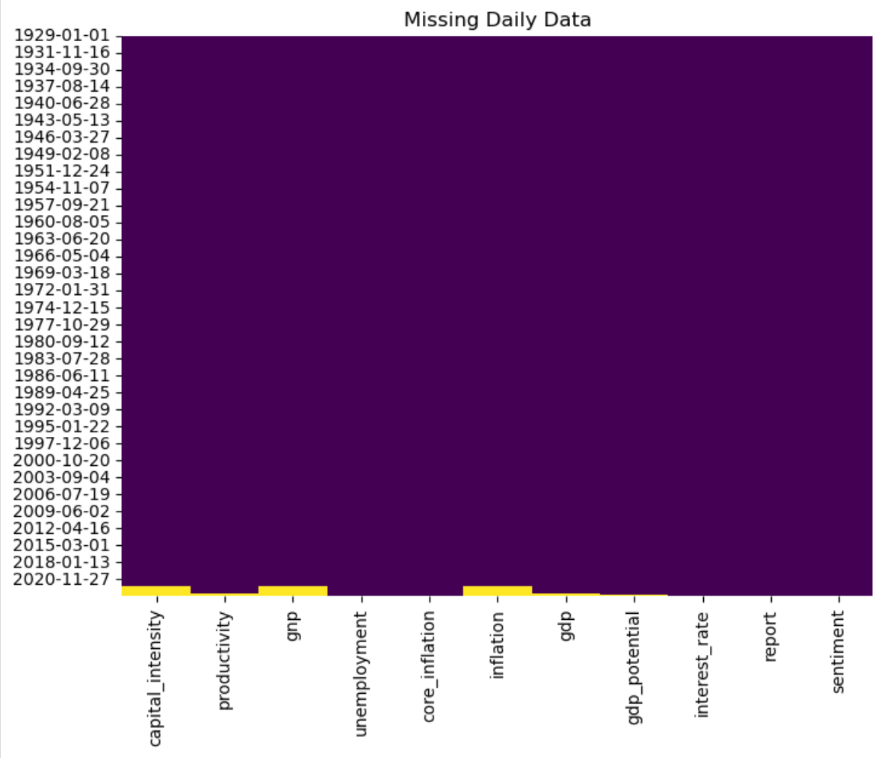
Imputing Data: Method

Slide 11
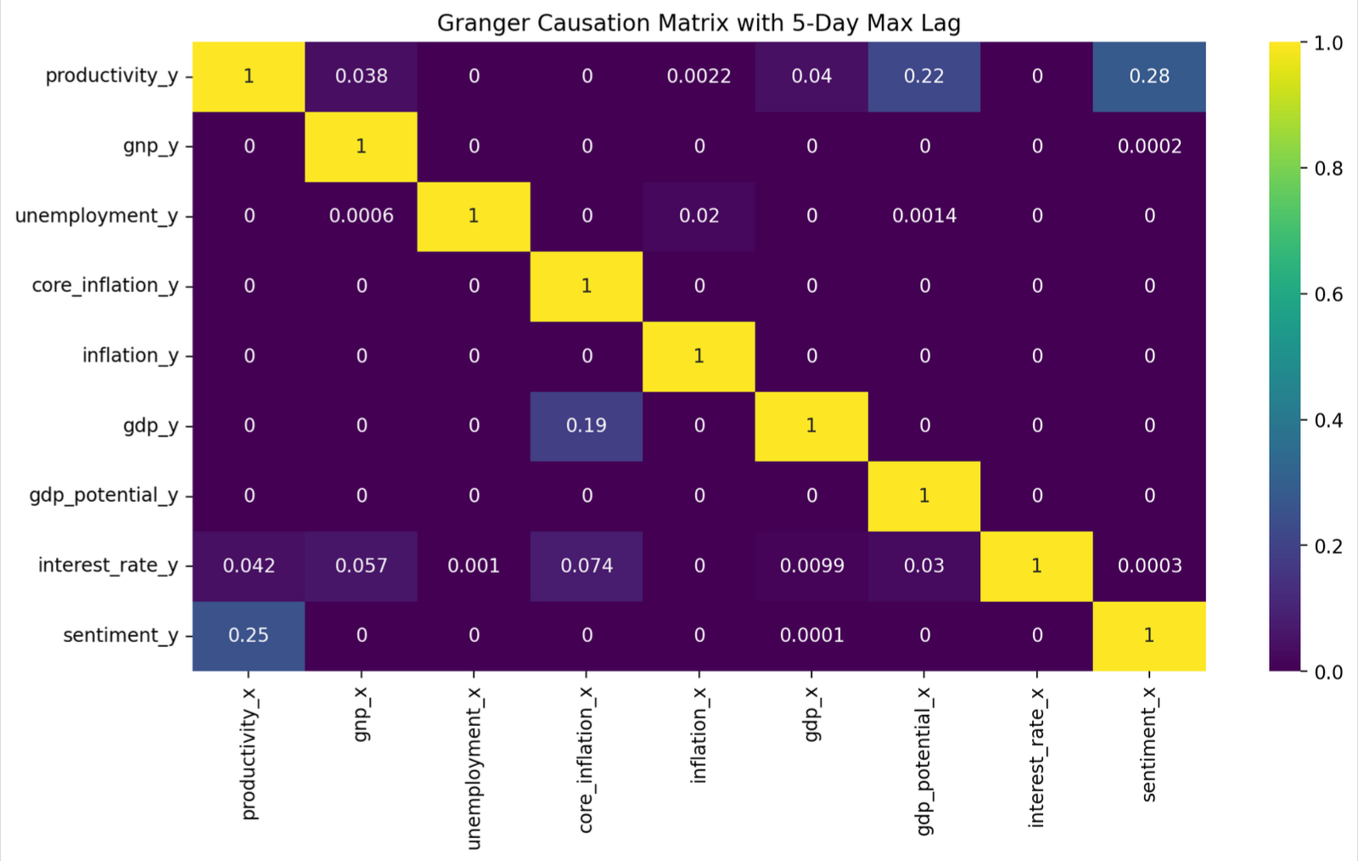
EDA: Granger Causation Matrix

Slide 12
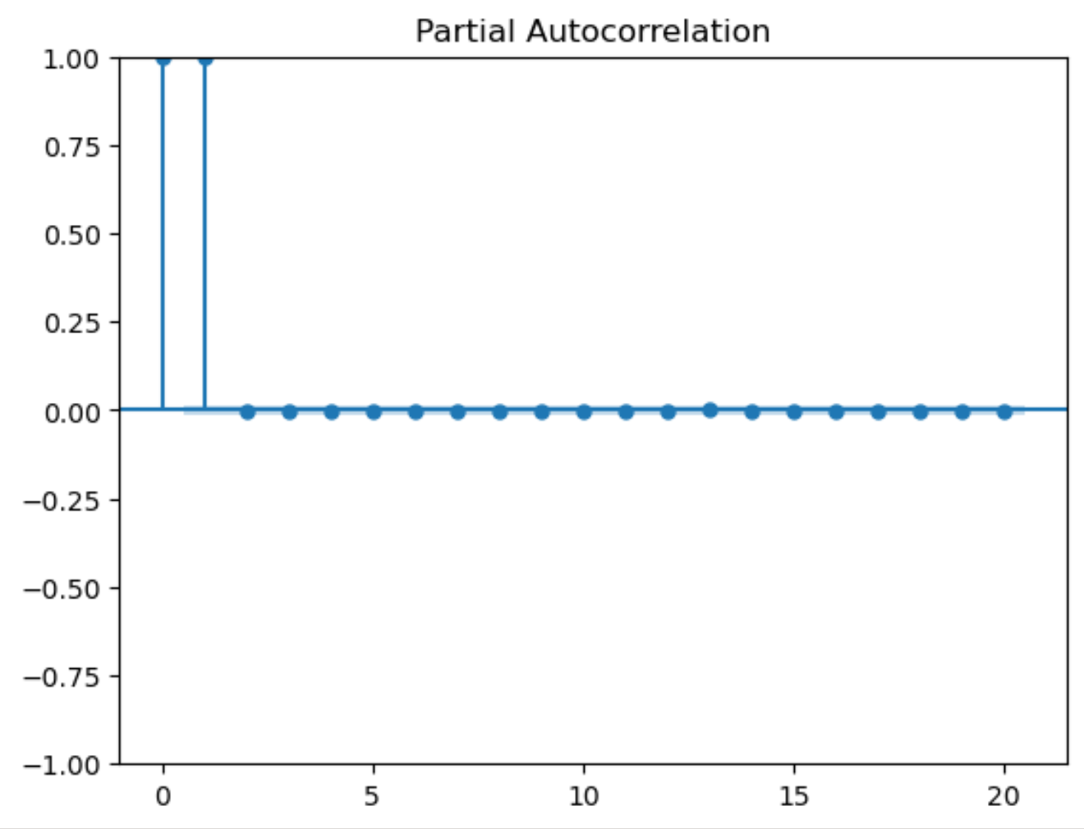
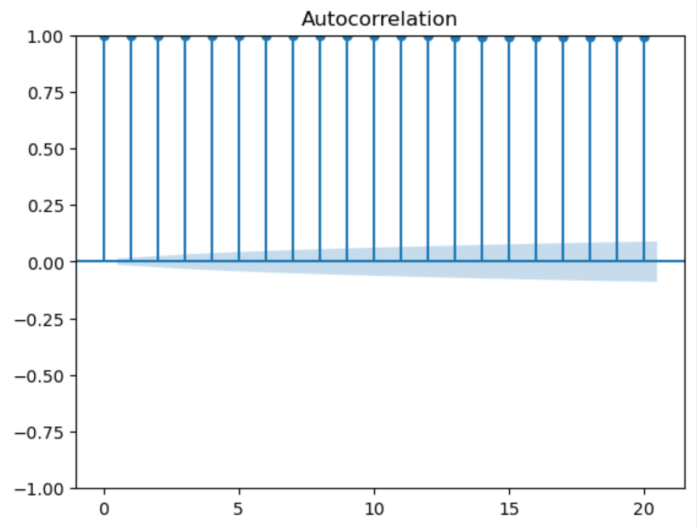
EDA: Autocorrelation on Interest Rates

Slide 13
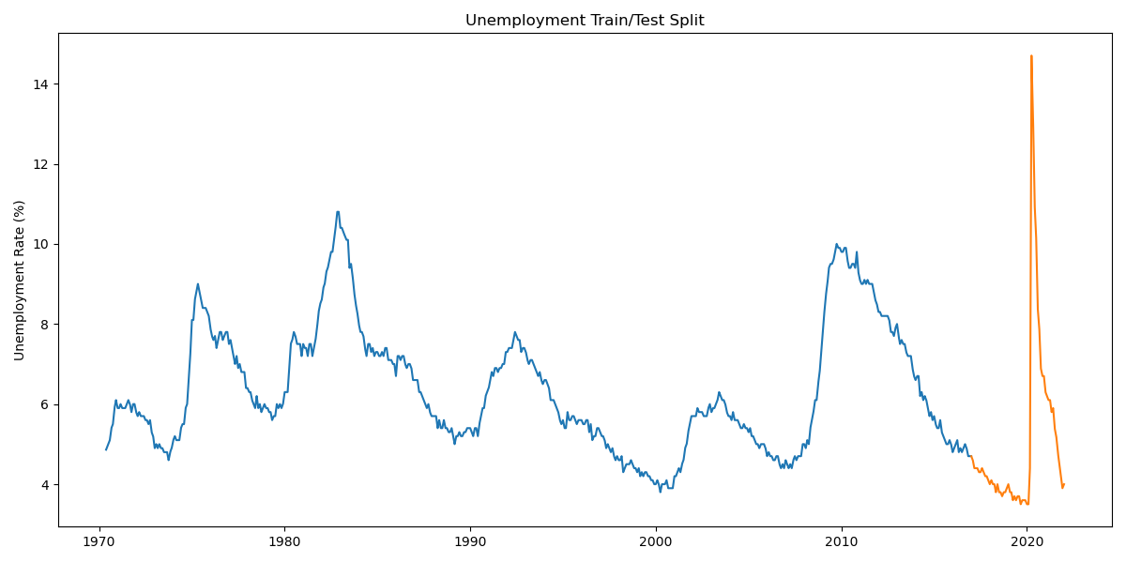
Modeling: Train/Test Split

Slide 14
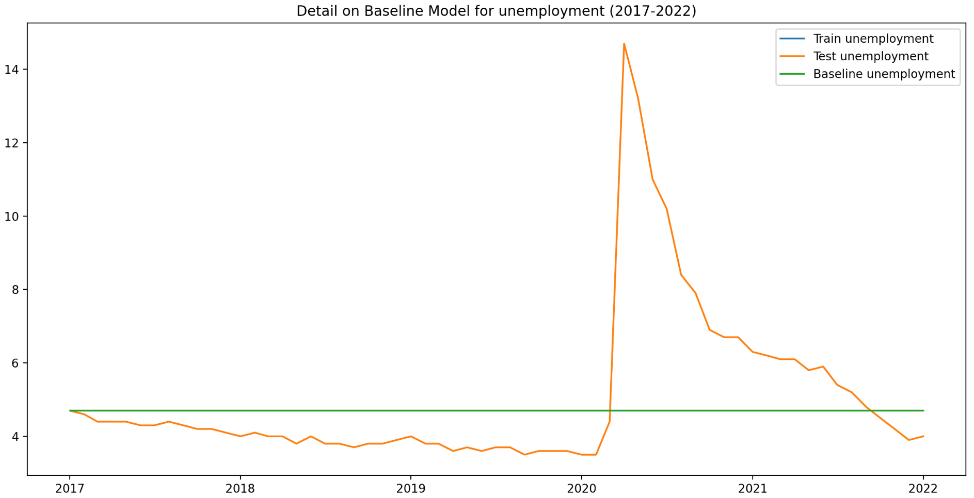
Modeling: Baseline

Slide 15
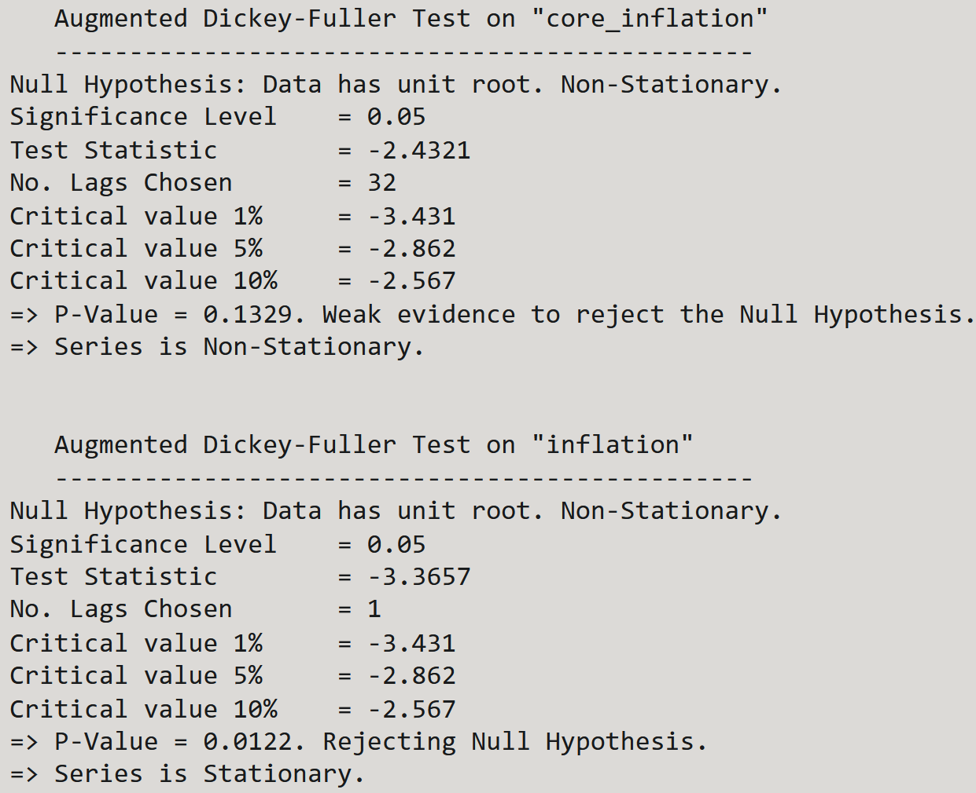
Modeling: Dickey-Fuller

Slide 16
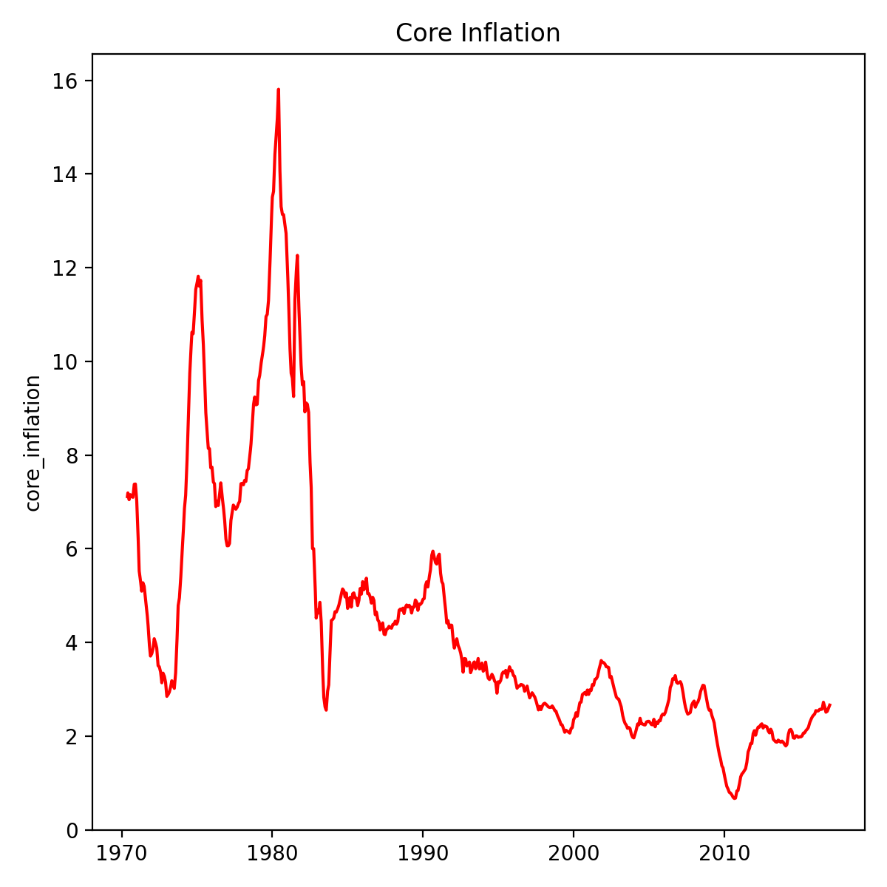
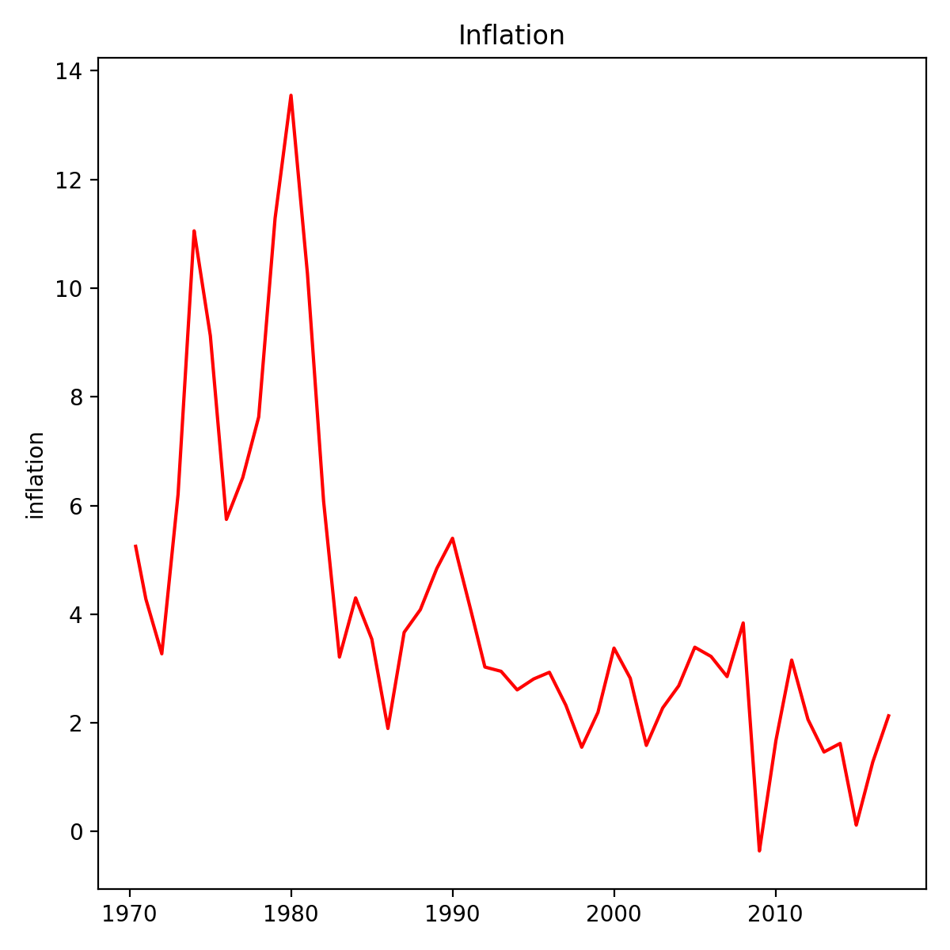
Modeling: Dickey-Fuller

Slide 17
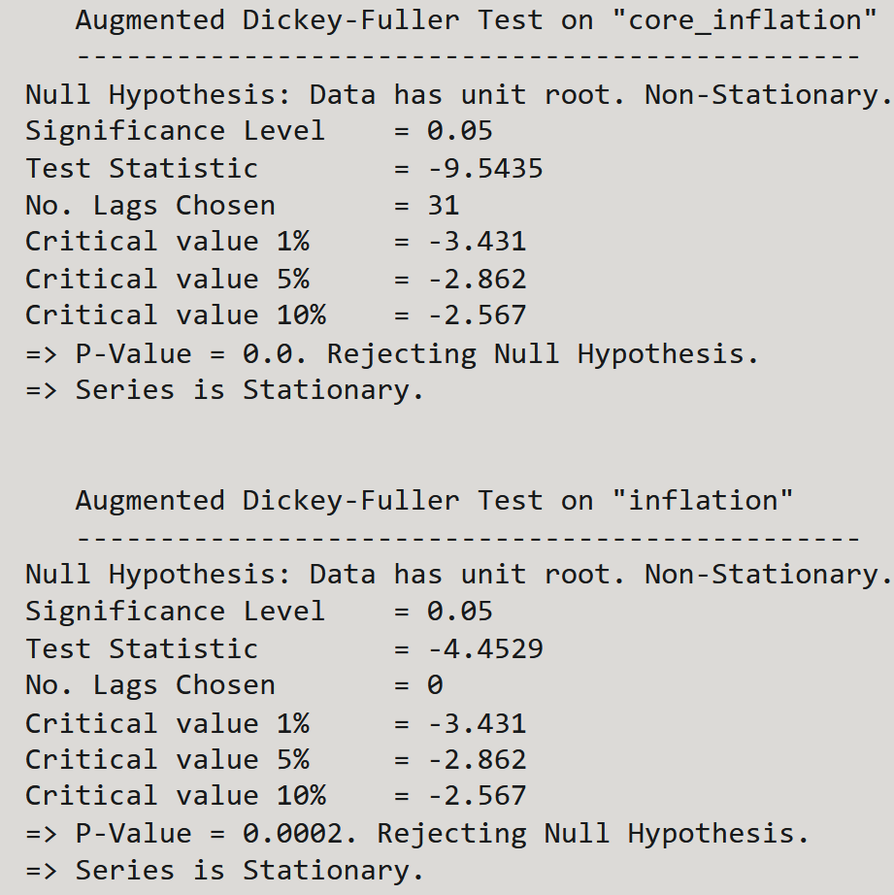
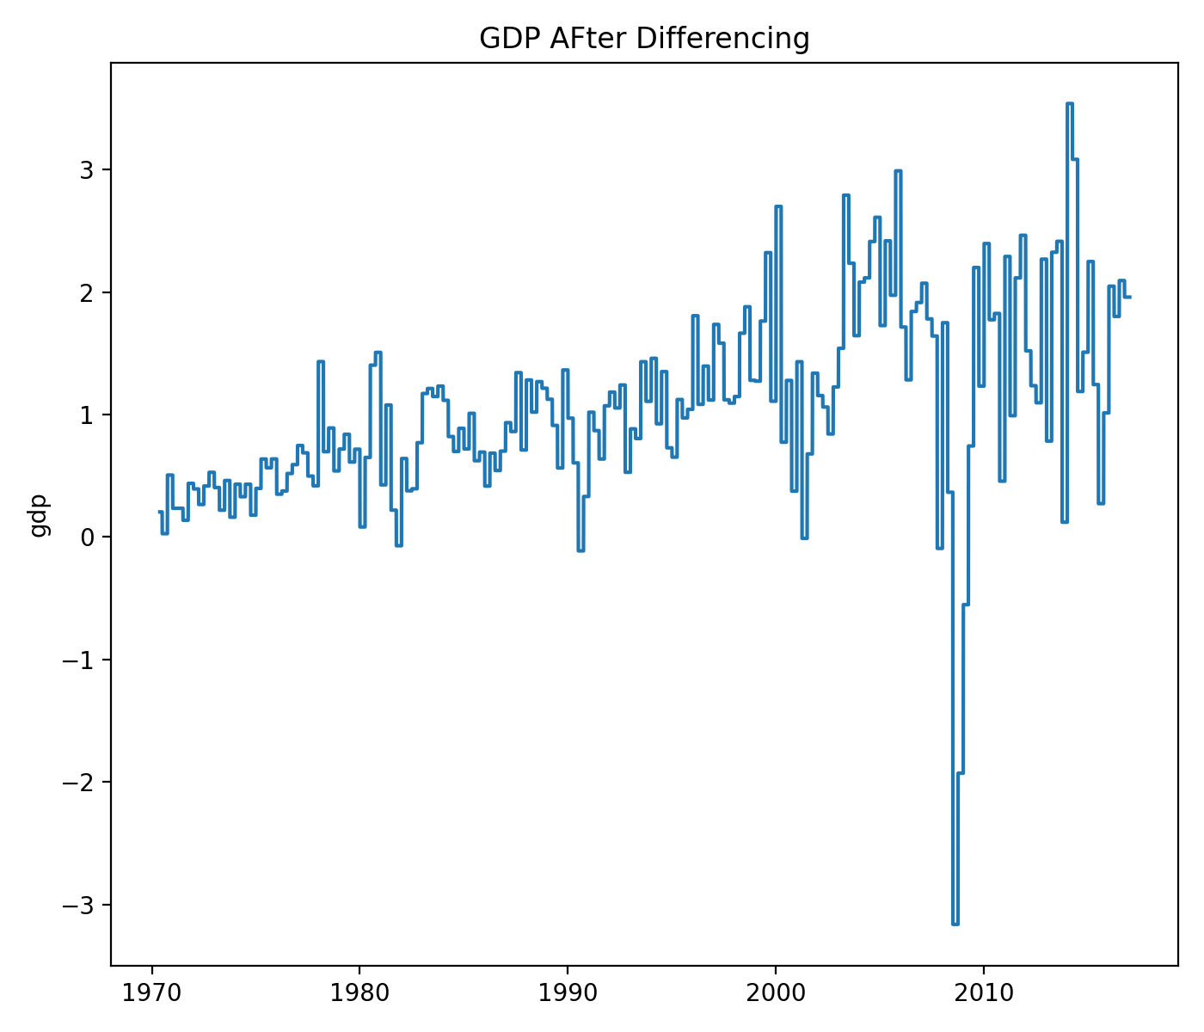
Modeling: Differencing

Slide 18
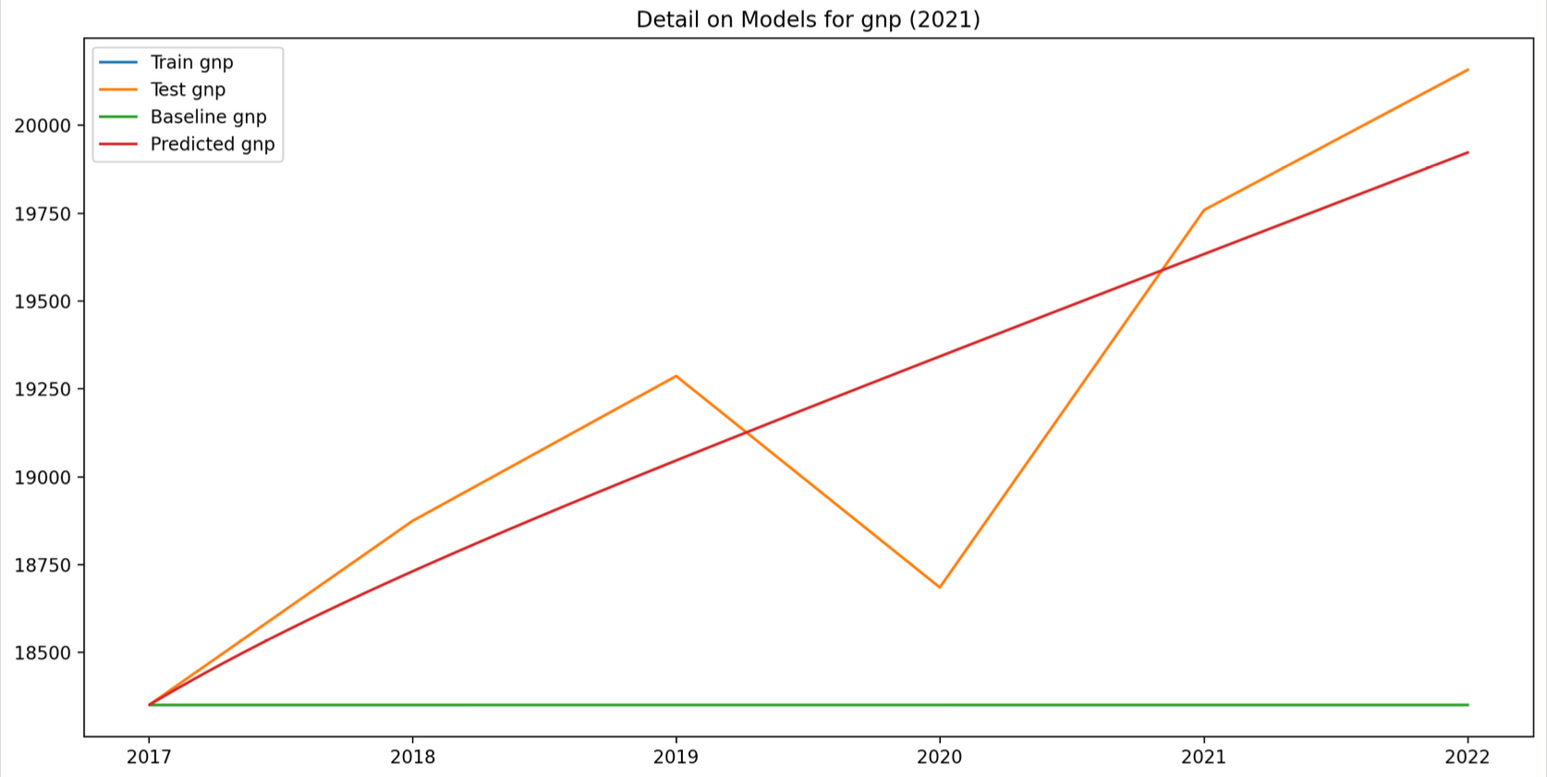
Modeling: Vector Autoregression

Slide 19
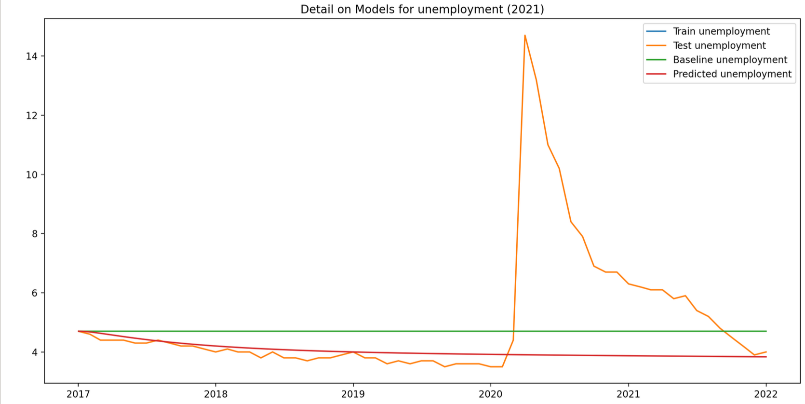
Modeling: Vector Autoregression

Slide 20
Modeling: Vector Autoregression

Slide 21
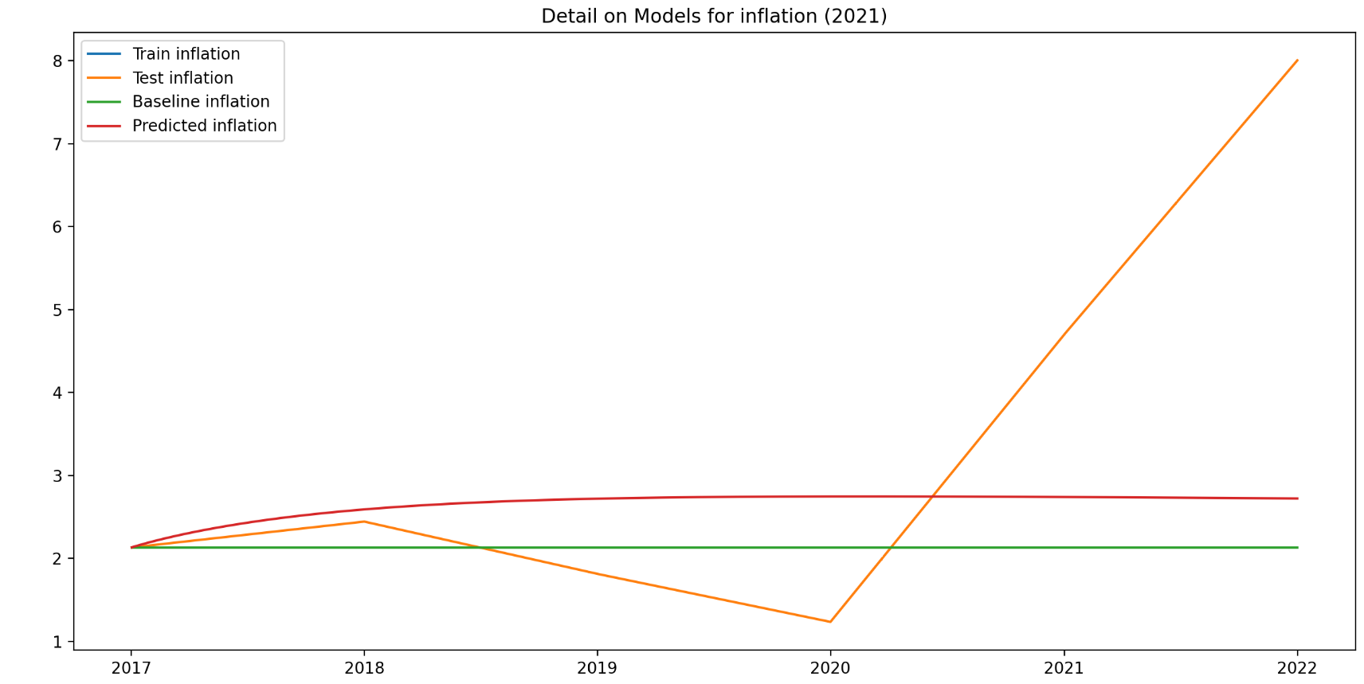
Modeling: Vector Autoregression

Slide 22
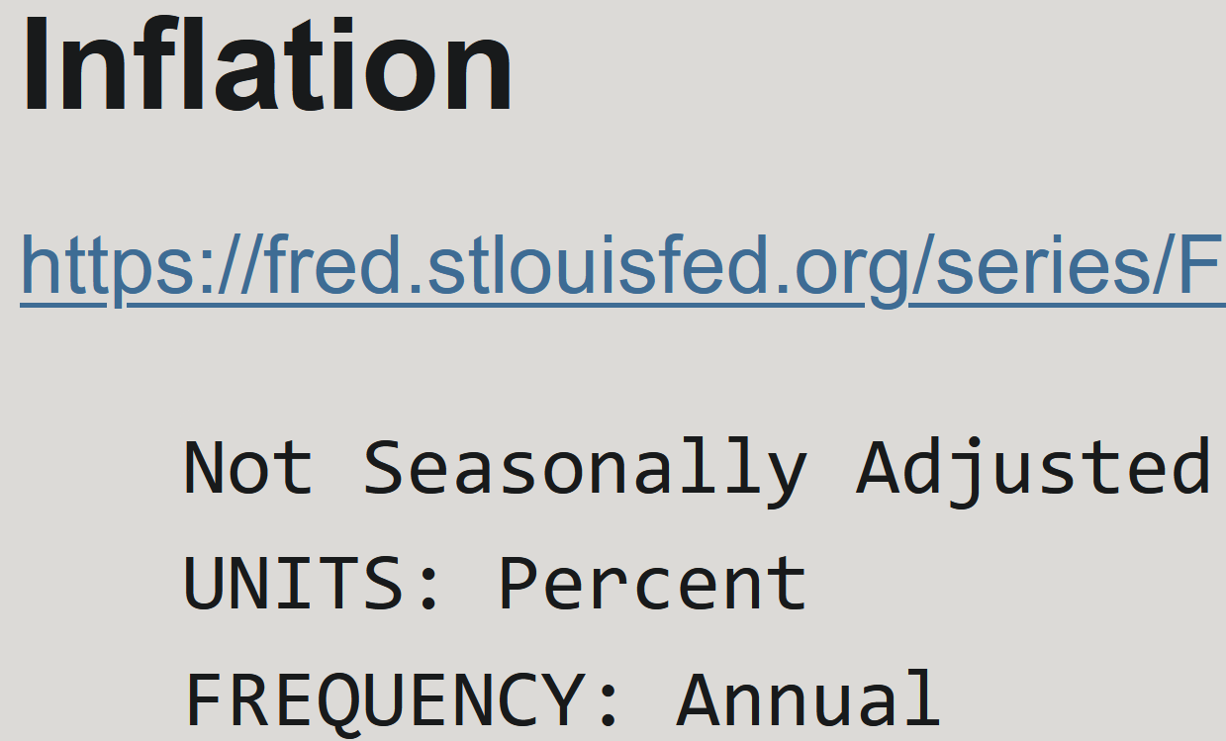
Modeling: Vector Autoregression

Slide 23
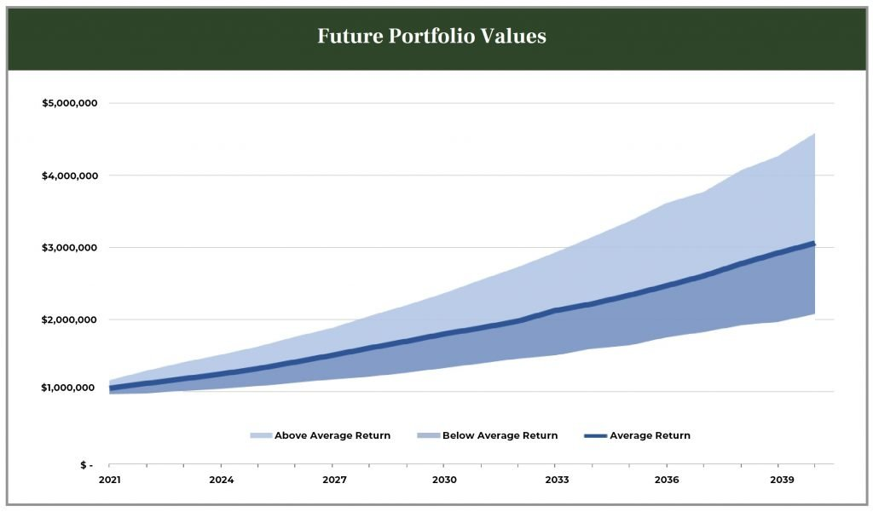
Conclusion: Other Approaches
https://www.eagleridgeinvestment.com/wp-content/uploads/2021/06/ERI-Future-Portfolio-Values-1024x601.jpg

